Slide 2
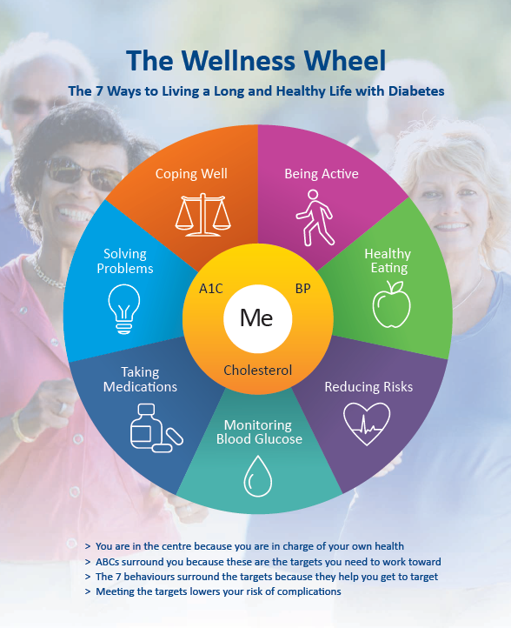

Slide 3
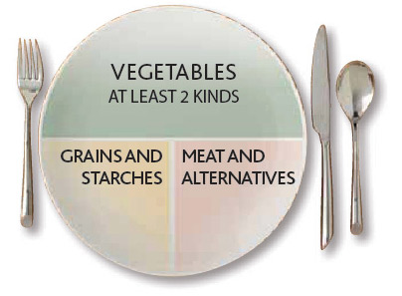
Healthy Eating:
Getting Started
1.5 hrs
·Learn how healthy eating can
improve your health and your
blood glucose
·Learn about balanced meals
and portion management

Slide 4
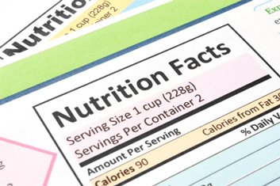
Healthy Eating:
Carb Counting
1.5 hrs
·Learn which foods have carbs
and how to count them
·Learn what food labels tell
you
·Practice how to make healthy
food choices

Slide 5
Meters & Meds
1.5 hrs
·Learn about diabetes
medications
·Learn what blood glucose
numbers mean for you
·Learn how to prevent and
treat low blood glucose

Slide 6
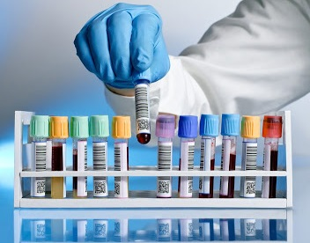
Passport to Health
1.75 hrs
·Learn what lab results tell you
·Learn what high BG can do to
your body
·Learn how to partner with
your health care providers

Slide 7
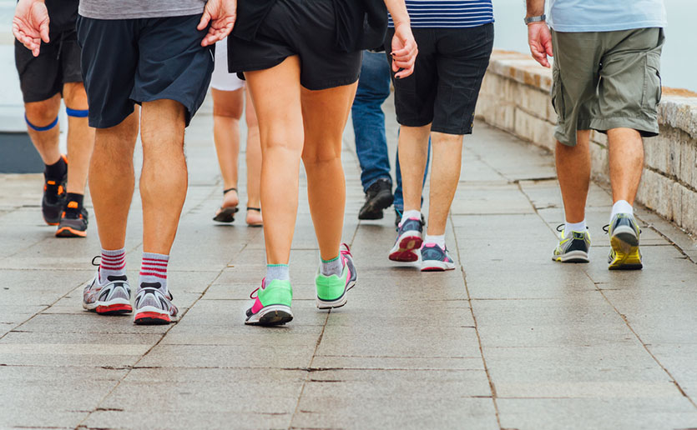
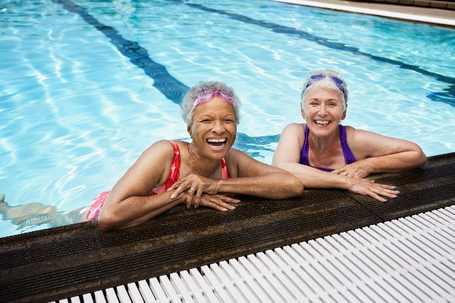
Being Active
2 hrs
·Learn how exercise can help
you
·Make a personalized plan
·Try using resistance bands

Slide 8
Stress & Diabetes
1.5 hrs
·Learn about the emotional
impacts of diabetes
·Learn tips & ideas for
handling stress and difficult
situations
·Learn how to get more
support

Slide 9
Virtual Workshops Now Available!
Join Us For Virtual Diabetes Education Workshops!

Slide 10
It’s Easy to Register!
Call 613-233-6655
or
Sign up at the end of class

